Slide 1

Dialogs,
Customizations, Basic Data Management
Copyright© Jeffrey Jongko, Ateneo de Manila University

Slide 2
Overview
Built-in Dialogs
  DatePickerDialog
  TimePickerDialog
  AlertBuilder
Custom Dialogs/Toasts and Images
Shared Preferences / File System

Slide 3
Built-in Dialogs
Copyright© Jeffrey Jongko, Ateneo de Manila University

Slide 4
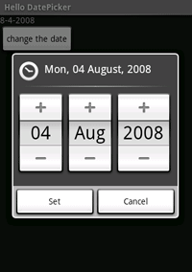
Dialogs
A dialog is a modal input type
  You must finish with the dialog before proceeding with anything else
Once a Dialog object is instanced, you can make it appear by calling its show() method

Slide 5
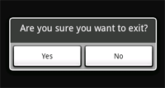
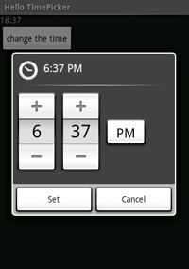

Built-in Dialogs
Built-in Dialogs
  DatePickerDialog
  TimePickerDialog
  AlertDialog
  ProgressDialog

Slide 6
DatePickerDialog
Standard widget for selecting a date, use the DatePicker widget (usable from the GraphicalEditor), which allows the user to select the month, day, and year, in a familiar interface.
A Dialog-based version is also available, DatePickerDialog

Slide 7
DatePickerDialog
DatePickerDialog follows the same basic principles of dialogs
  Initialize the dialog
  Call the show() method

Slide 8
OnDateSetListener
You need to define the close behaviour of a DatePickerDialog
This is the DatePickerDialog.OnDateSetListener
  Defines one method
    public void onDateSet(DatePicker view, int year, int monthOfYear, int dayOfMonth)

Slide 9
Example
private DatePickerDialog.OnDateSetListener mDateSetListener =
new DatePickerDialog.OnDateSetListener() {
public void onDateSet(DatePicker view, int year,
int monthOfYear, int dayOfMonth) {
mYear = year;
mMonth = monthOfYear;
mDay = dayOfMonth;
updateDisplay();
}
};
protected void openDatePicker {
Dialog d = new DatePickerDialog(this,
mDateSetListener,
mYear, mMonth, mDay);
d.show();
}

Slide 10
Calendar objects
Java’s basic date/time handling class is the Calendar object
Allows for the setting and retrieving information about date/time using simple constants
Calendar c = Calendar.getInstance();
mYear = c.get(Calendar.YEAR);
mMonth = c.get(Calendar.MONTH);
mDay = c.get(Calendar.DAY_OF_MONTH);

Slide 11
Calendar
A detailed description of Calendar’s methods and constants can be found here
  file:///C:/android-sdk-windows/docs/reference/java/util/Calendar.html

Slide 12
TimePickerDialog
TimePicker is similar to the DatePicker except it is used to handle hour/minute, time of day
TimePickerDialog is the dialog version of the TimePicker
Just like with the DatePickerDialog you can use a Calendar object to hold data received from this dialog

Slide 13
OnTimeSetListener
private TimePickerDialog.OnTimeSetListener mTimeSetListener =
new TimePickerDialog.OnTimeSetListener() {
public void onTimeSet(TimePicker view, int hourOfDay, int minute) {
mHour = hourOfDay;
mMinute = minute;
updateDisplay();
}
};
protected void openTimeDialog() {
Dialog d = new TimePickerDialog(this,
mTimeSetListener, mHour, mMinute, false);
d.show();
}

Slide 14
AlertDialog
Copyright© Jeffrey Jongko, Ateneo de Manila University

Slide 15
AlertDialog
An AlertDialog is an extension of the Dialog class. It is capable of constructing most dialog user interfaces and is the suggested dialog type. You should use it for dialogs that use any of the following features:
  A title
  A text message
  One, two, or three buttons
  A list of selectable items (with optional checkboxes or radio buttons)

Slide 16
AlertDialog.Builder
AlertDialogs are created using the AlertDialog.Builder class
Using the builder you may supply the required information
  Title, button names, etc.
The final Dialog instance is built using the create() method

Slide 17
Example 1
AlertDialog.Builder builder = new AlertDialog.Builder(this);
builder.setMessage("Are you sure you want to exit?")
.setCancelable(false)
.setPositiveButton("Yes", new DialogInterface.OnClickListener() {
public void onClick(DialogInterface dialog, int id) {
// positive action
exit()
}
})
.setNegativeButton("No", new DialogInterface.OnClickListener() {
public void onClick(DialogInterface dialog, int id) {
// negative action
dialog.cancel();
}
});
AlertDialog alert = builder.create();

Slide 18
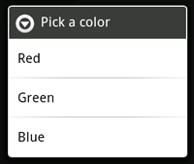
Example 2
final CharSequence[] items = {"Red", "Green", "Blue"};
AlertDialog.Builder builder = new AlertDialog.Builder(this);
builder.setTitle("Pick a color");
builder.setItems(items, new DialogInterface.OnClickListener() {
public void onClick(DialogInterface dialog, int item) {
Toast.makeText(getApplicationContext(), items[item], Toast.LENGTH_SHORT).show();
}
});
AlertDialog alert = builder.create();

Slide 19
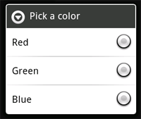
Example 3
final CharSequence[] items = {"Red", "Green", "Blue"};
AlertDialog.Builder builder = new AlertDialog.Builder(this);
builder.setTitle("Pick a color");
builder.setSingleChoiceItems(items, -1, new DialogInterface.OnClickListener() {
public void onClick(DialogInterface dialog, int item) {
// do something
}
});
AlertDialog alert = builder.create();
To use checkboxes, use setMultiChoiceItems() instead

Slide 20
Notes:
Note the getApplicationContext() calls in defining DialogInterface.OnClickListener
  Retrieves the Activity instance
    Can’t use this since it will refer to the DialogInterface.OnClickListener instance
  Lists of strings do not need to be hard-coded, they can also be placed in the values

Slide 21
ProgressDialog
A ProgressDialog is an extension of the AlertDialog class that can display a progress animation in the form of a spinning wheel, for a task with progress that's undefined, or a progress bar, for a task that has a defined progression
  Used in conjunction with Threads

Slide 22
Customizations

Slide 23
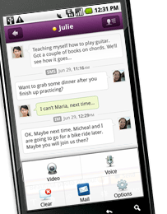
Introduction
Not all Android apps look the same
  i.e. the default bland black and white look
Most have custom looks like
  Background images
  Coloured text
  Image Icons/Buttons
  Animation
  Etc.

Slide 24
Images
Images are placed in the drawable folders of /res
There are three drawable folders, one for each category of screen size
  drawable-hdpi
  drawable-mdpi
  drawable-ldpi
Each folder corresponds to resources to be used for a specific screen size category

Slide 25
Image Size Categories
Android defines 3 broad image size categories
  hdpi, mdpi, ldpi
Each one should hold resources appropriate to the size
  This is needed due to Android’s automatic resizing
    Resizing smaller images results in lower quality on larger screens
Images should have the same name in each category
  Supported image types are: PNG and JPG

Slide 26
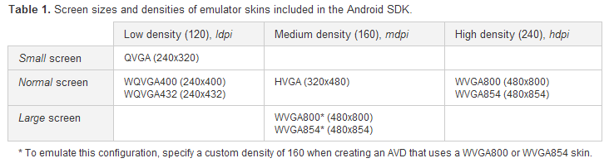
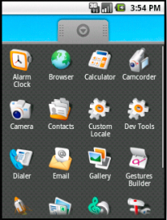
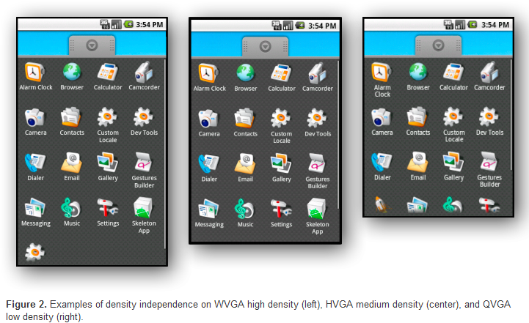
Multiple Screen Support

Slide 27
ImageView
Images can be easily added to an existing View Hierarchy
  An ImageView is a type of View used to hold an image
  Used as a placeholder for images
    E.g. for icons on a menu

Slide 28
Example
<ImageView android:src="@drawable/icon"
android:id="@+id/imageView1"
android:layout_width=“wrap_content"
android:layout_height="match_parent">
</ImageView>
The image used is specified using the @drawable/<name>
The name of the image is the image filename in the drawable folder
  i.e. either icon.png or icon.jpg
Layouting parameters automatically stretch a smaller image to a larger space or shrink a larger image to a smaller space as needed

Slide 29
Colours
View can have their backgrounds replaced with either and image of a color
android:background="#FF0000”
  # followed by the hexidecimal RGB color
android:background=“@drawable/ic_launcher"

Slide 30
Menu Customization

Slide 31
Custom Menus
Options menus options can have icons associated to them
Built-in Context menus cannot take icons

Slide 32
Custom Menu via XML
<?xml version="1.0" encoding="utf-8"?>
<menu xmlns:android="http://schemas.android.com/apk/res/android">
<item android:id="@+id/new_game"
android:icon="@drawable/ic_new_game"
android:title="@string/new_game" />
<item android:id="@+id/help"
android:icon="@drawable/ic_help"
android:title="@string/help" />
</menu>
Adding icons to options menus is easy simply add an android:icon attribute with the image id

Slide 33
Custom Dialogs
Copyright© Jeffrey Jongko, Ateneo de Manila University

Slide 34
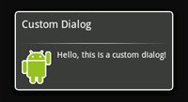
CustomDialogs
Generally AlertDialog is all you will need for most Dialog requirements
  If you can get away with AlertDialog use it
If AlertDialog does not provide what you need, it is possible to define your own Dialog layout
  The process is similar to defining an Activity layout

Slide 35
Making your own Dialog
If you want a customized design for a dialog, you can create your own layout for the dialog window with layout and widget elements.
After you've defined your layout, pass the root View object or layout resource ID to setContentView(View).
  Use a LayoutInflator similar to a MenuInflator to create a ViewGroup from a layout XML
  Use the ViewGroup’s findViewById(id) to edit individual widgets

Slide 36
dismiss()
When you're ready to close your dialog, you can dismiss it by calling dismiss() on the Dialog object.

Slide 37
OnDismissListener
Sometimes you want to do something as a result of dismissing a dialog
  First define the DialogInterface.OnDismissListener interface.
  This interface has just one method,onDismiss(DialogInterface), which will be called when the dialog is dismissed.
  pass your OnDismissListener implementation to setOnDismissListener() of the dialog when you create it

Slide 38
Cancelling a Dialog
However, note that dialogs can also be "cancelled."
This is a special case that indicates the dialog was explicitly cancelled by the user. This will occur if
  the user presses the "back" button to close the dialog
  if the dialog explicitly calls cancel() (perhaps from a "Cancel" button in the dialog).

Slide 39
OnCancelListener
When a dialog is cancelled, the OnDismissListener will still be notified, but if you'd like to be informed that the dialog was explicitly cancelled (and not dismissed normally), then you should register an DialogInterface.OnCancelListener with setOnCancelListener()

Slide 40
android:onClick
WARNING: this attribute does not work for layouts used in Dialogs. Always use a listener to handle button presses in a Dialog

Slide 41
More Info
More details on custom dialogs can be found here
    file:///C:/android-sdk-windows/docs/guide/topics/ui/dialogs.html

Slide 42
Custom Toasts

Slide 43
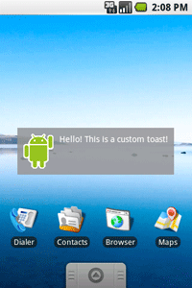
Custom Toasts
Toasts do not have to look like plain text on black
They can be fully customized like an Activity
  Simply define a layout using the GraphicalEditor or XML
  Attach this to the Toast

Slide 44
Example
<LinearLayout xmlns:android="http://schemas.android.com/apk/res/android"
android:id="@+id/toast_layout_root"
android:orientation="horizontal"
android:layout_width="fill_parent"
android:layout_height="fill_parent"
android:padding="10dp"
android:background="#DAAA"
>
<ImageView android:id="@+id/image"
android:layout_width="wrap_content"
android:layout_height="fill_parent"
android:layout_marginRight="10dp"
/>
<TextView android:id="@+id/text"
android:layout_width="wrap_content"
android:layout_height="fill_parent"
android:textColor="#FFF"
/>
</LinearLayout>
Save this as toast_layout.xml

Slide 45
Example
LayoutInflater inflater = getLayoutInflater();
View layout = inflater.inflate(R.layout.toast_layout,
(ViewGroup) findViewById(R.id.toast_layout_root));
ImageView image = (ImageView) layout.findViewById(R.id.image);
image.setImageResource(R.drawable.android);
TextView text = (TextView) layout.findViewById(R.id.text);
text.setText("Hello! This is a custom toast!");
Toast toast = new Toast(getApplicationContext());
toast.setGravity(Gravity.CENTER_VERTICAL, 0, 0);
toast.setDuration(Toast.LENGTH_LONG);
toast.setView(layout);
toast.show();
Load the layout and initialize the views
Create a Toast
Attach the layout to a Toast and provide other initializations
show()

Slide 46
Note
Do not use the public constructor for a Toast unless you are going to define the layout with setView(View).
If you do not have a custom layout to use, you must use makeText(Context, int, int) to create the Toast as before

Slide 47
Data Management

Slide 48
Saving Data
Android provides several ways to save data
  SharedPreferences
  File access (SD card)
  SqlLite database

Slide 49
Shared
Preferences

Slide 50
SharedPreferences
Shared Preferences store small amount of simple data
The SharedPreferences class provides a general framework that allows you to save and retrieve persistent key-value pairs of primitive data types.

Slide 51
SharedPreferences
You can use Shared Preferences to save any primitive data: booleans, floats, ints, longs, and strings. This data will persist across user sessions (even if your application is killed).

Slide 52
SharedPreferences
To use SharedPreferences you need an instance
SharedPreferences prefs = getSharedPreferences(String name,int mode);
name – corresponds to the name of the store
  You can access the same store throughout the application via this name
mode – defines who can access this data

Slide 53
SharedPreferences.Editor
The Editor class allows you to save key/value pairs to the preferences file by exposing methods such as the following:
  putString(String name, String val)
  putInt(String name, int val)
  putFloat(String name, float val)
  putBoolean(String name, boolean val)
  putLong(String name, long val)

Slide 54
Example
SharedPreferences prefs = getSharedPreferences(“my_data”,MODE_PRIVATE);
SharedPreferences.Editor editor = prefs.edit();
editor.putInt(10);
editor.putString(“test”);
editor.putBoolean(true);
editor.commit();

